Slide 1
Big Data Analytics
簡廷因 Ting-Ying Chien
2017.02.21

Slide 2
Big Data Analytics
Teacher
簡廷因
tinin@saturn.yzu.edu.tw
tinin@mars.csie.ntu.edu.tw
Time
Tue 09:10 – 12:00
Place
1201A
Office hour
Tue 14:00 – 16:00

Slide 3
Big Data Analytics
TA
Not sure
Facebook
https://www.facebook.com/groups/241512166298966/

Slide 4
Reference Book
Big Data Analytics with R and Hadoop
ISBN : 978-1-78216-328-2
http://lib.yzu.edu.tw/ajaxYZlib/Search/Holding.aspx?BiblioSNo=594427
Hadoop in Action
ISBN : 9781935182191
http://lib.yzu.edu.tw/ajaxYZlib/Search/Holding.aspx?BiblioSNo=442516

Slide 5
Online Resource
R
http://www.r-project.org/
http://manuals.bioinformatics.ucr.edu/home/R_BioCondManual
http://www.statmethods.net/
Hadoop
http://hadoop.apache.org/
Spark
https://spark.apache.org/

Slide 6
Score
Homework:30%
Min * 5 % + Max * 7% + the others * 6%
R programming
Shiny + Open data
Final Project Proposal
Paper Work
Record a video to introduce your final project
Mid: 30%
Final Project: 40 %

Slide 7
Final Project
Team Project
2~3 persons
https://goo.gl/yhXwSa
A workshop
Join with CS332A大數據科學導論, CS321AＵＮＩＸ系統概論

Slide 8
Final Project
Competitions
http://www.kaggle.com/competitions
http://dreamchallenges.org/
http://saschampion.com.tw/
Others competitions
Innovation Project
https://hackathon.tw/
https://opendata-contest.tca.org.tw/purpose.aspx
Others

Slide 9
Final Project
Bonus
The top 3 in a competition (# teams > 50)
Final score = 99

Slide 10
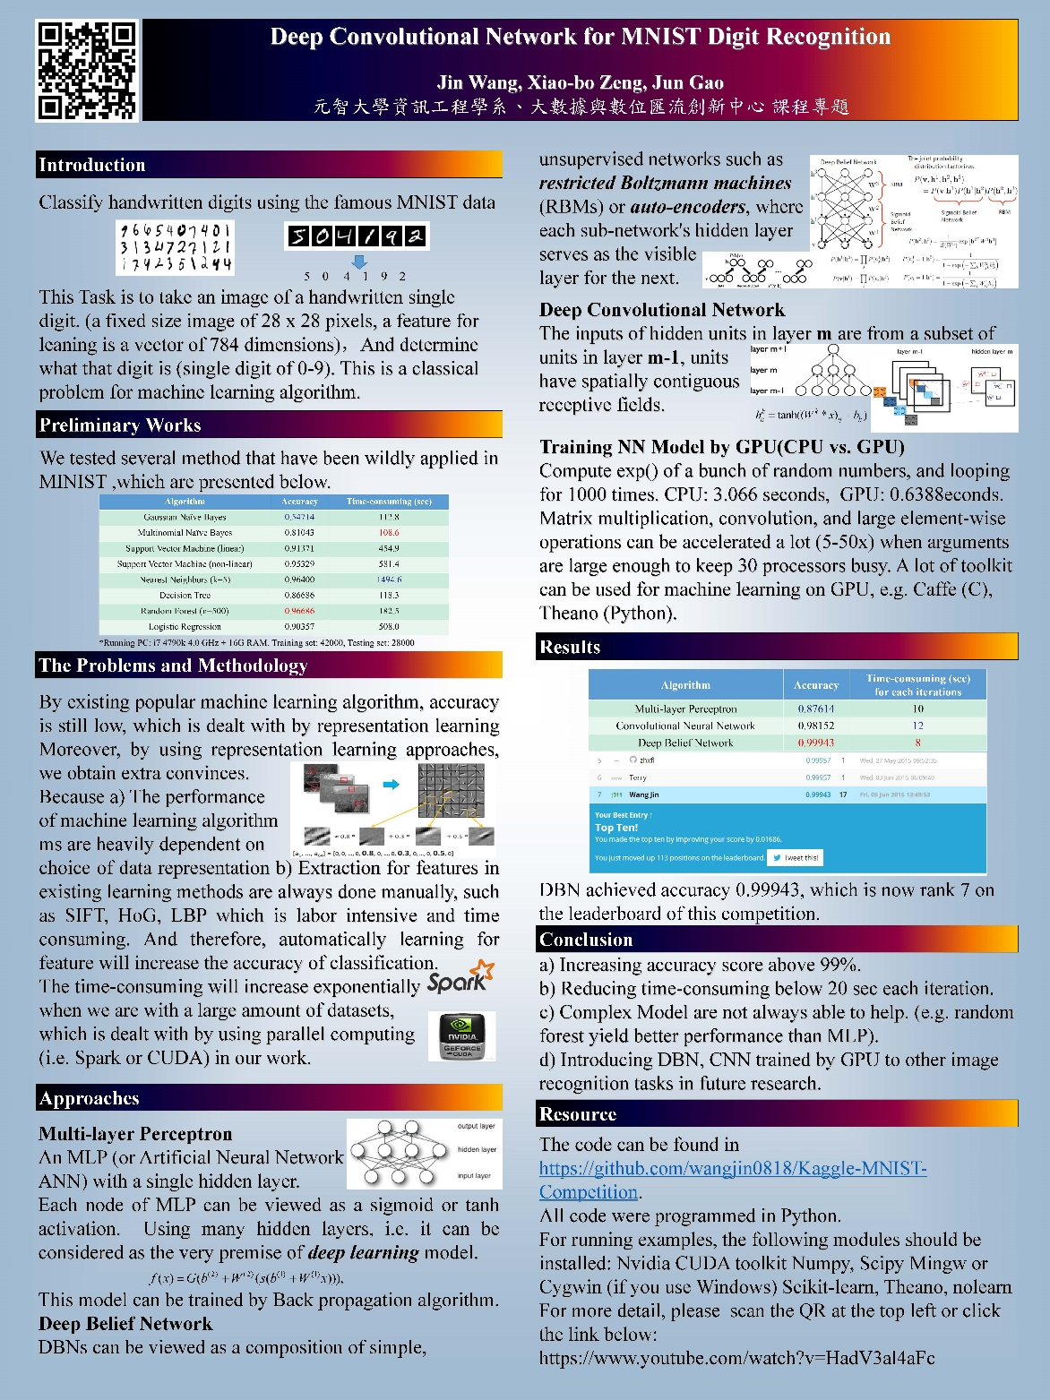
1032 Final Project

Slide 11
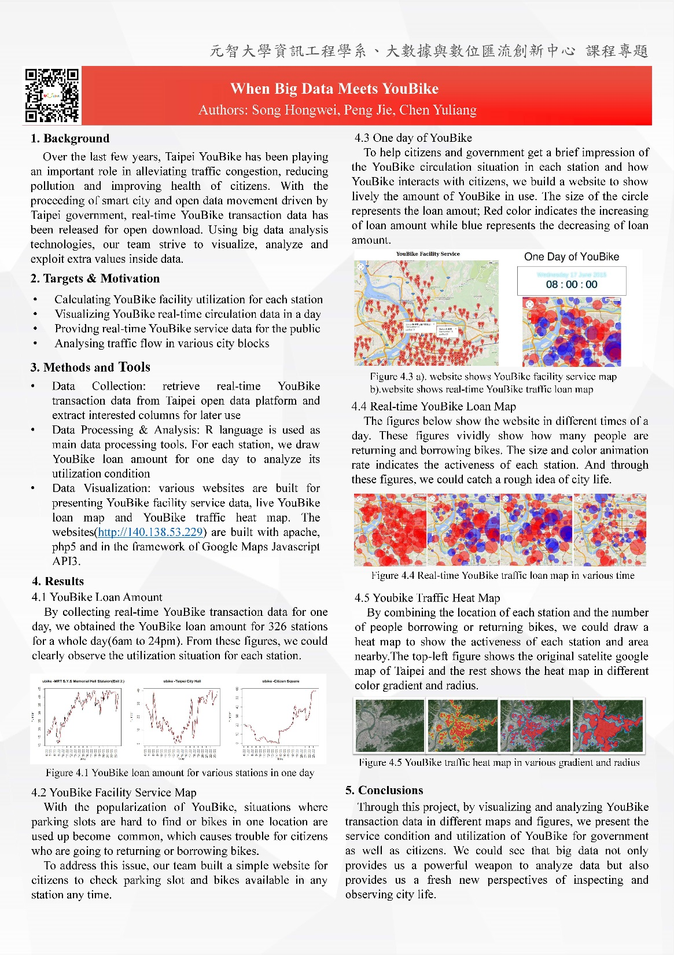
1032 Final Project

Slide 12
Submit Homework
Portal
Portal -> Homework
Demo

Slide 13
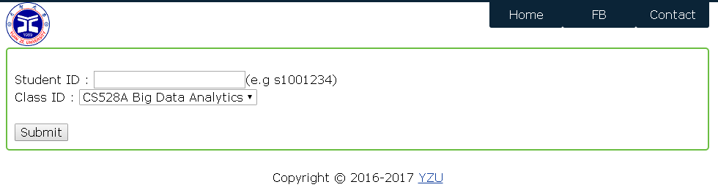
Sign in
http://140.138.77.210/bigdata/
1 day 1IP for 1 person

Slide 14
Outline
2016/02/21 | Comprehensive introduction
2016/02/28 | Suspend classes (228 vacation)
2016/03/07 | Introduction to analytic tools for big data
2016/03/14
2016/03/21
2016/03/28 | R Shiny
2016/04/04 | Tomb Sweeping Day (Ching Ming Festival)
2016/04/11 | Introduction to data mining algorithm
2016/04/18 | Midterm
2016/04/25 | Introduction to data mining machine learning
2016/05/02 | Introduction to big data platform
2016/05/09
2016/05/16 | Final project proposal
2016/05/23 | RHadoop
2016/05/30 | Dragon Boat Festival
2016/06/06 | Text Mining
2016/06/13
2016/06/20 | Final project demo

Slide 15
Pre-requisite
Computer Programming
Probability and Statistics
Introduction to UNIX System
Introduction to Database System

Slide 16
公約
I care
作業抄襲
該次作業0分，累犯者前幾次均為0分(抄與被抄)等同
考試作弊
請重修，情節嚴重者校規處置
作業遲交
遲交一天扣該次作業10分，扣到0為止
不能含有病毒
該次作業以0分計
不打擾他人上課
上課不能吃東西
依教室規定

Slide 17
公約
I don’t care
上課舉手發問
我的課堂上沒有笨問題
上課錄音
旁聽
但請先尊重修課同學
請同學包含
投影片會很晚放到portal
投影片可能常會修改
我有時可能會掛黑板

Slide 18
Q&A

